Slide 1
LSTM Parameters
input_size – The number of expected features in the input x
hidden_size – The number of features in the hidden state h
num_layers – Number of recurrent layers. E.g., setting num_layers=2 would mean stacking two LSTMs together to form a stacked LSTM, with the second LSTM taking in outputs of the first LSTM and computing the final results. Default: 1
bias – If False, then the layer does not use bias weights b_ih and b_hh. Default: True
batch_first – If True, then the input and output tensors are provided as (batch, seq, feature). Default: False
dropout – If non-zero, introduces a Dropout layer on the outputs of each LSTM layer except the last layer, with dropout probability equal to dropout. Default: 0
bidirectional – If True, becomes a bidirectional LSTM. Default: False
Input of LSTM: input, (h_0, c_0)
input of shape (seq_len, batch, input_size): tensor containing the features of the input sequence. The input can also be a packed variable length sequence. See torch.nn.utils.rnn.pack_padded_sequence() or torch.nn.utils.rnn.pack_sequence() for details.
h_0 of shape (num_layers * num_directions, batch, hidden_size): tensor containing the initial hidden state for each element in the batch. If the LSTM is bidirectional, num_directions should be 2, else it should be 1.
c_0 of shape (num_layers * num_directions, batch, hidden_size): tensor containing the initial cell state for each element in the batch.If (h_0, c_0) is not provided, both h_0 and c_0 default to zero.
Output of LSTM: output, (h_n, c_n)

Slide 2
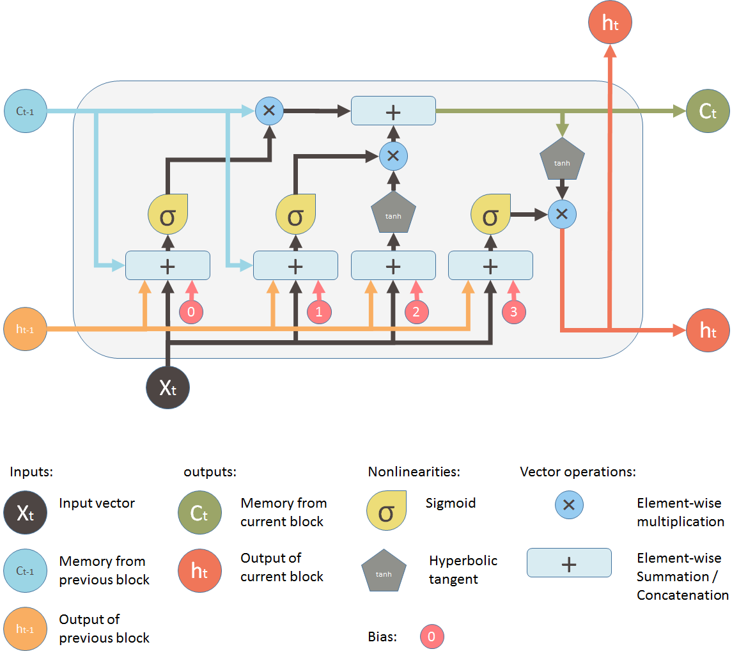
hidden state input
hidden_size: the number of features in hidden state, defined by the user, (256, 512) is commonly used
Input, usually we is the result after embedding
input_size: the number of features of x (embedding size)

Slide 3
h₀
h₁
h₂
h₃
LSTM
LSTM
LSTM
LSTM
num_layers
LSTM
LSTM
LSTM
LSTM
Embedding
Embedding
Embedding
Embedding
x0
x1
x2
x3
X_{i} is a element in one sequence, could be a word or stock price of one day
Length of the sequence

